Slide 1

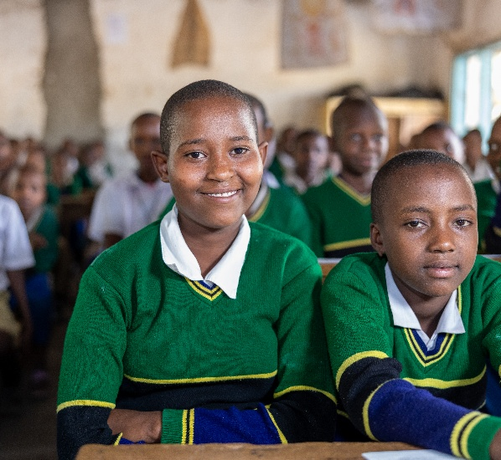
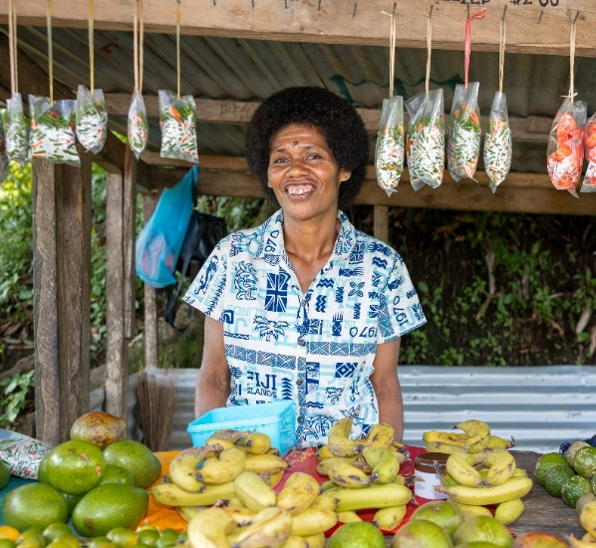
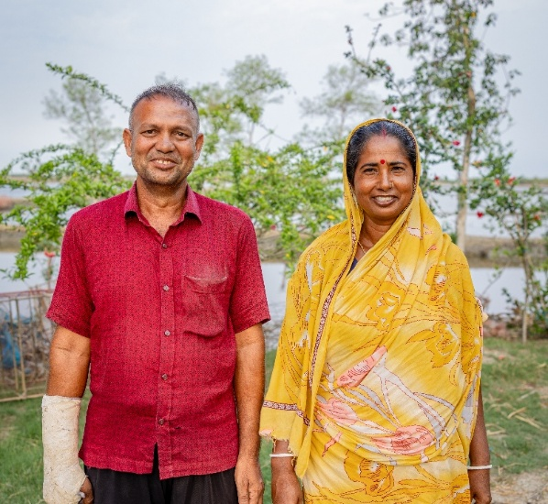
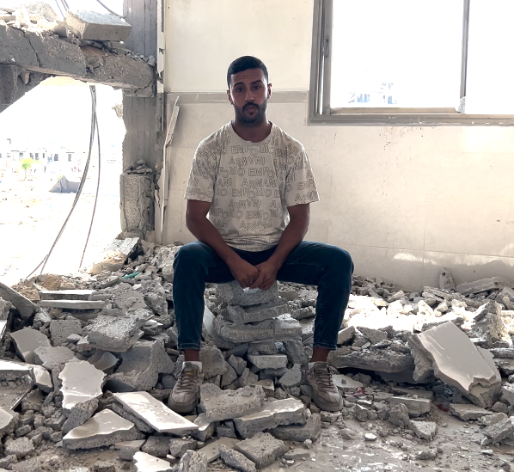
Introduction to Project Compassion 2026
Workplaces

Slide 2
Unite Against Poverty this Lent
Caritas Australia, the international aid and development agency behind Project Compassion, partners with communities across the globe to create sustainable change.
Project Compassion calls on us to Unite Against Poverty and a reminder that lasting change happens when we work together.
It's about standing alongside people experiencing poverty and injustice, and supporting them to build better futures.
Through Project Compassion, we live out this call together. Alone, we can make a difference, but united, we can transform lives.
Join us in 2026 as we Unite Against Poverty
and walk alongside our global family.

Slide 3
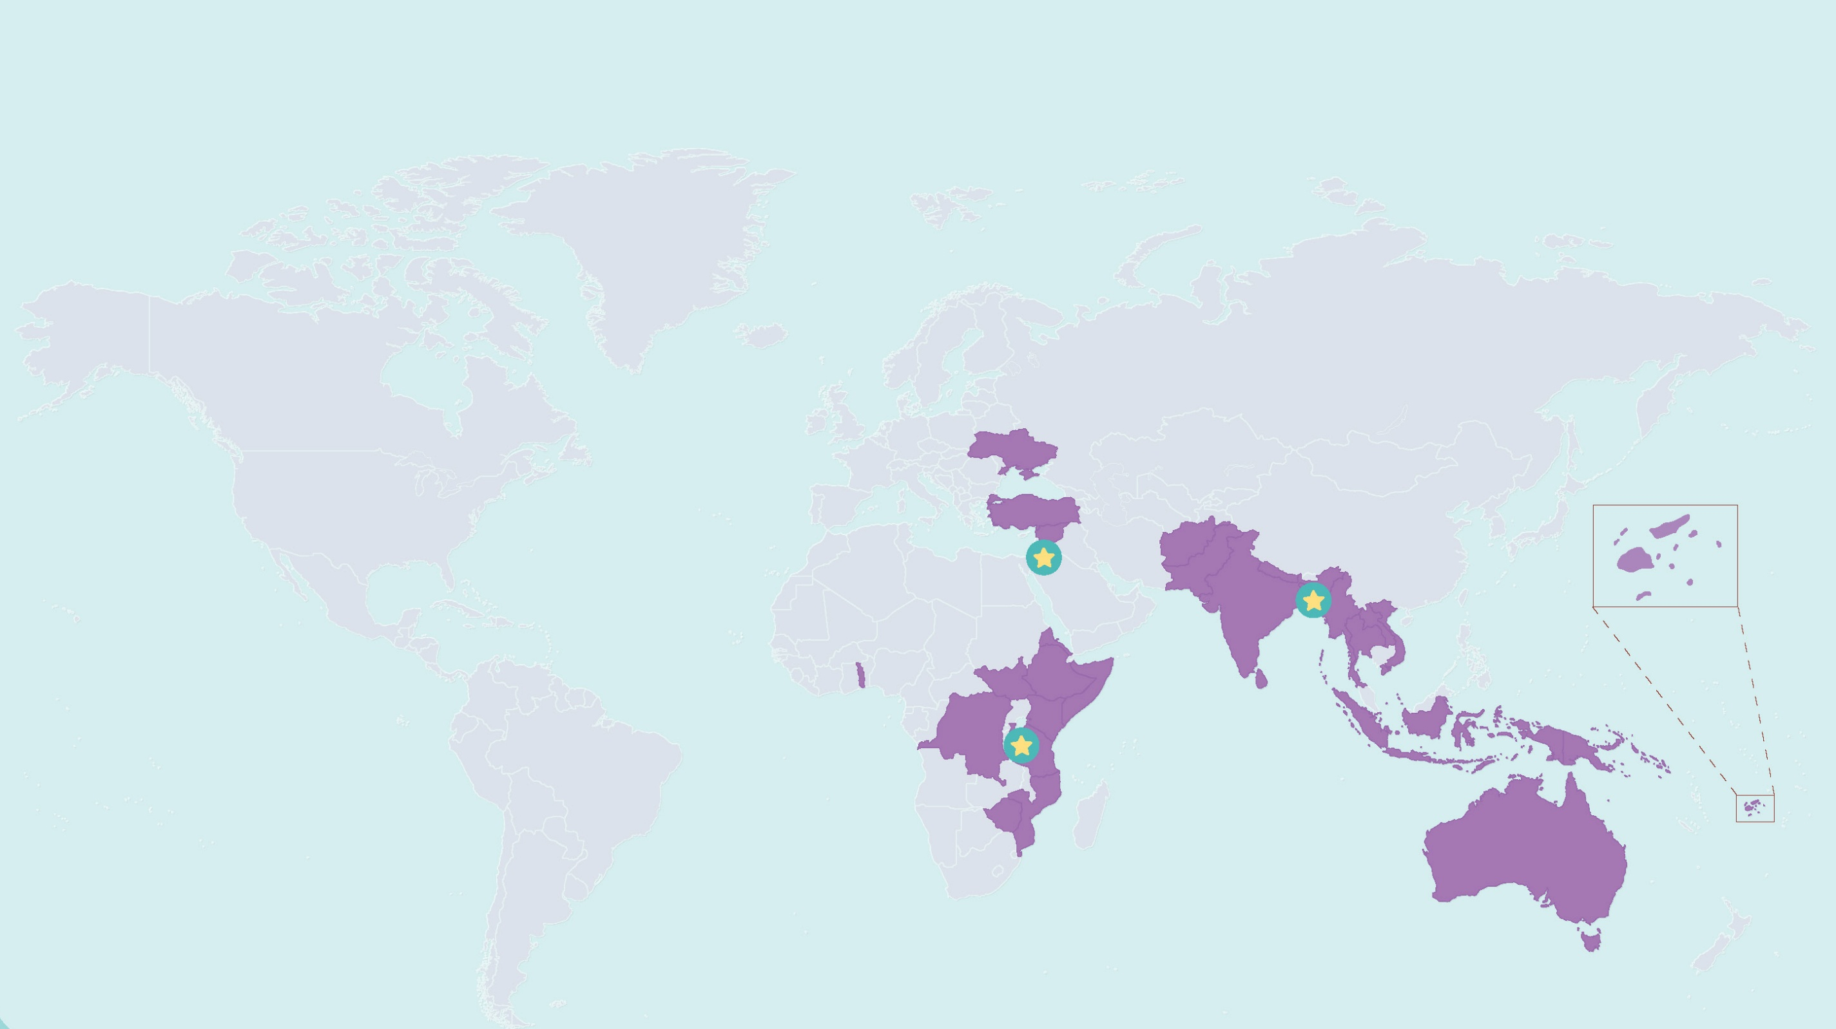

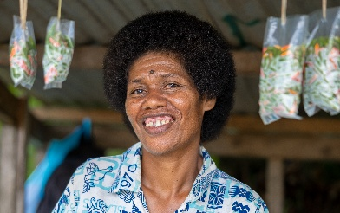
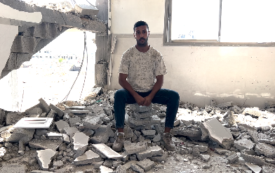
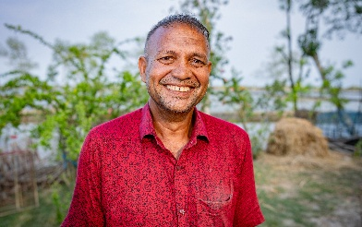
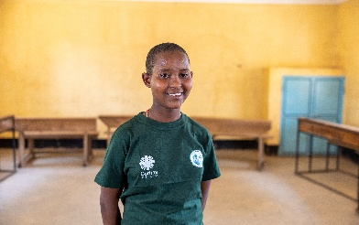
Where we work
For over 60 years, Caritas Australia has stood alongside communities in Australia and around the world, working together to create lasting change.
FIJI
GAZA
BANGLADESH
TANZANIA
WHERE WE WORK (EXC EMERGENCIES)
FEATURED COUNTRIES

Slide 4
Sisilia’s Story
Tanzania
Watch Sisilia's Story
Sisilia in a classroom in her school in rural Tanzania. Photo: Caritas Australia.

Slide 5
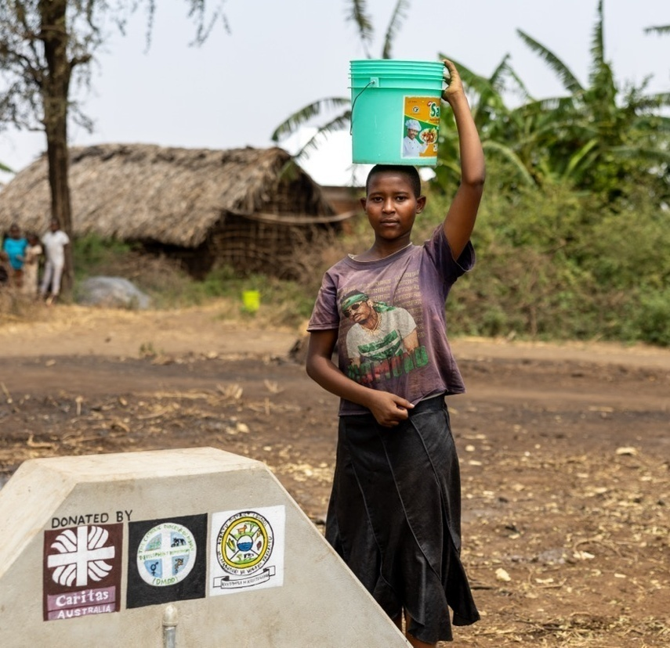
Sisilia’s Story
Tanzania
Sisilia, a 13-year-old from remote northern Tanzania, faced immense challenges including poverty, unsafe water and poor sanitation.
After her father passed away, she supported her mother by fetching water three times a day, often through unsafe and exhausting conditions that left little time for study.

Slide 6
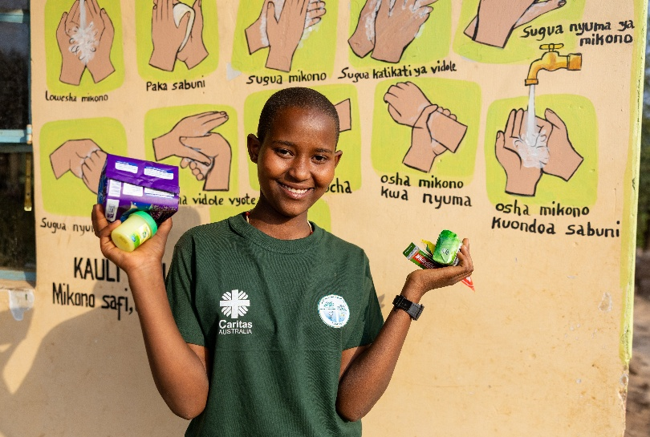
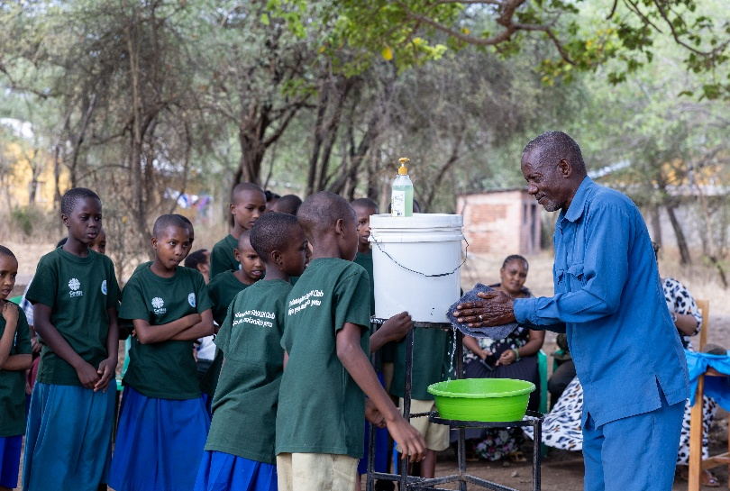
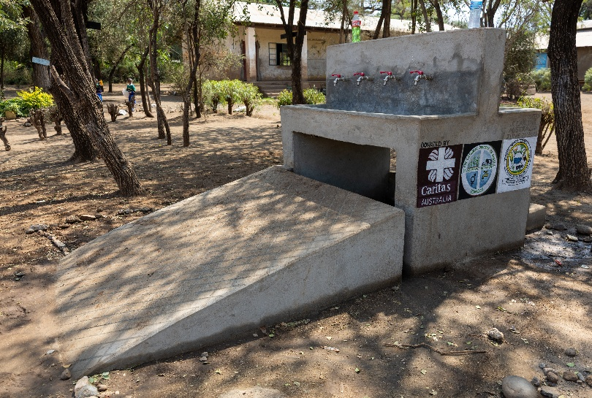
With your generosity, Caritas Australia’s local partner, Diocese of Mbulu Development Department (DMDD), can continue to support and connect communities like Sisilia’s through various programs and projects.
Hygiene products are distributed to SWASH club members.
SWASH club members use what they know to teach others in the community on how to wash their hands.
New water taps constructed at Sisilia’s school through the A+ Successor Project.

Slide 7
Monoranjon’s
Story
Bangladesh
Watch Monoranjon’s Story
Monoranjon lives in a region in southwest Bangladesh that is highly vulnerable to the effects of climate change. Photo: Caritas Australia

Slide 8
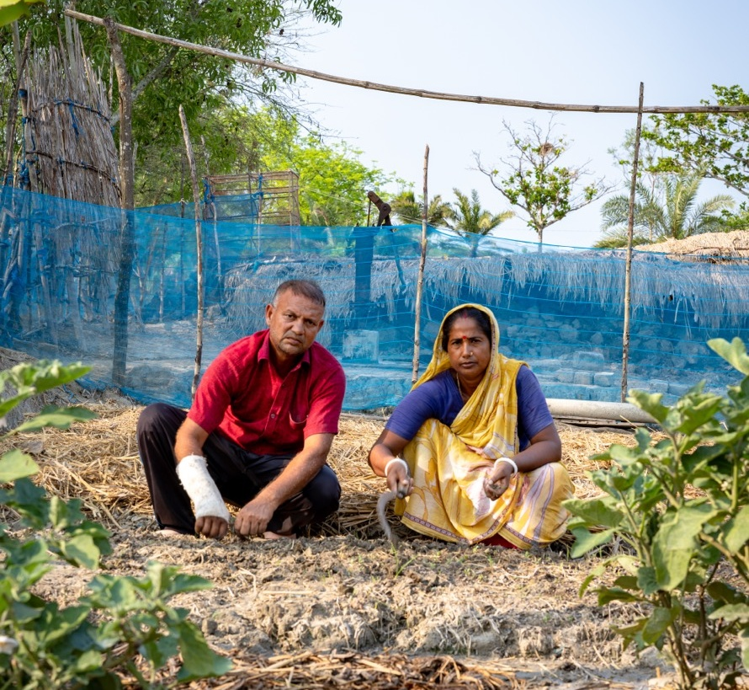
Monoranjon’s Story
Bangladesh
Monoranjon, a 47-year-old farmer from Bangladesh’s vulnerable southwest delta, faces the harsh impacts of climate change including extreme heat, cyclones, water scarcity, and rising salinity.
These challenges have threatened his crops, income, and his children's future.

Slide 9
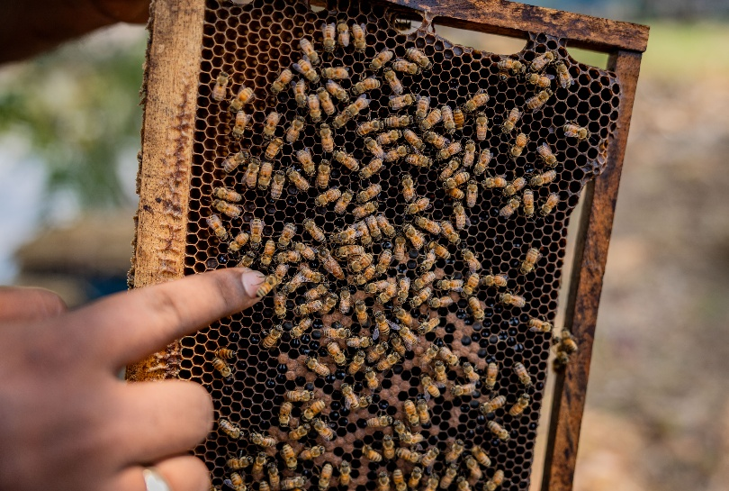
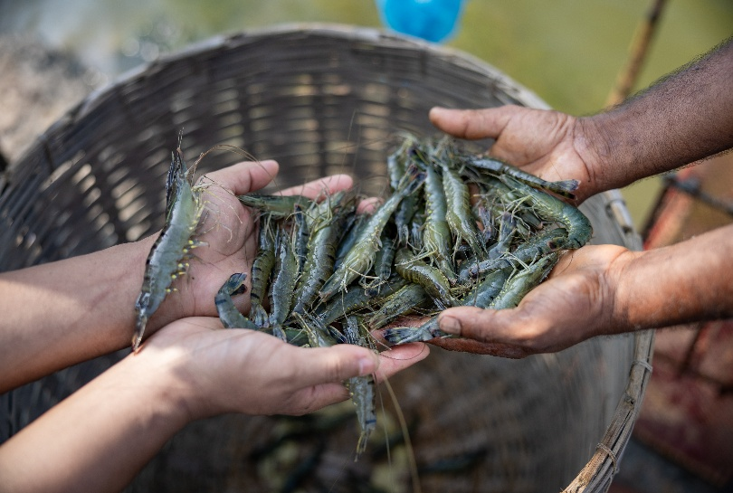
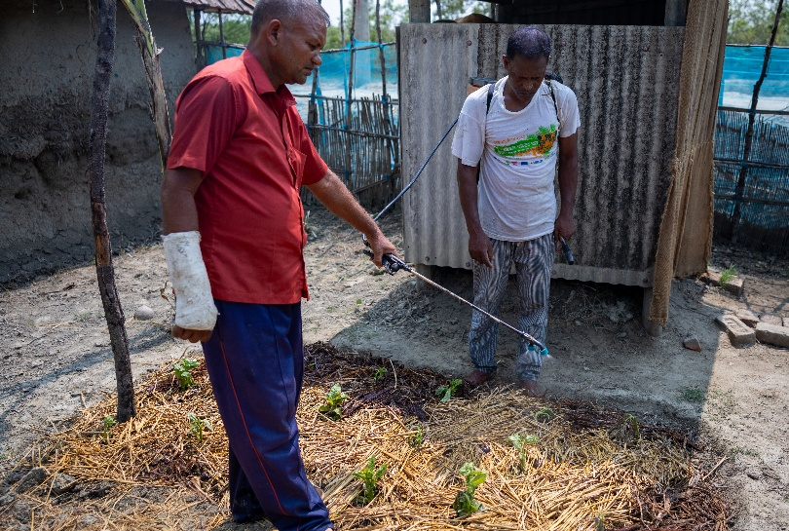
With your support, Monoranjon and his community are being taught new skills.
Monoranjon has been able to diversify his income through local beekeeping.
Through the program, farmers can learn how to catch prawns to sell for income.
Monoranjon now uses organic pesticides to protect his crops.

Slide 10
Manaini’s Story
Fiji
Watch Manaini’s Story
Manaini sells fresh fruits and vegetables that she and her community have grown and packaged on their farms, by the roadside in a small village in Fiji. Photo: Caritas Australia

Slide 11
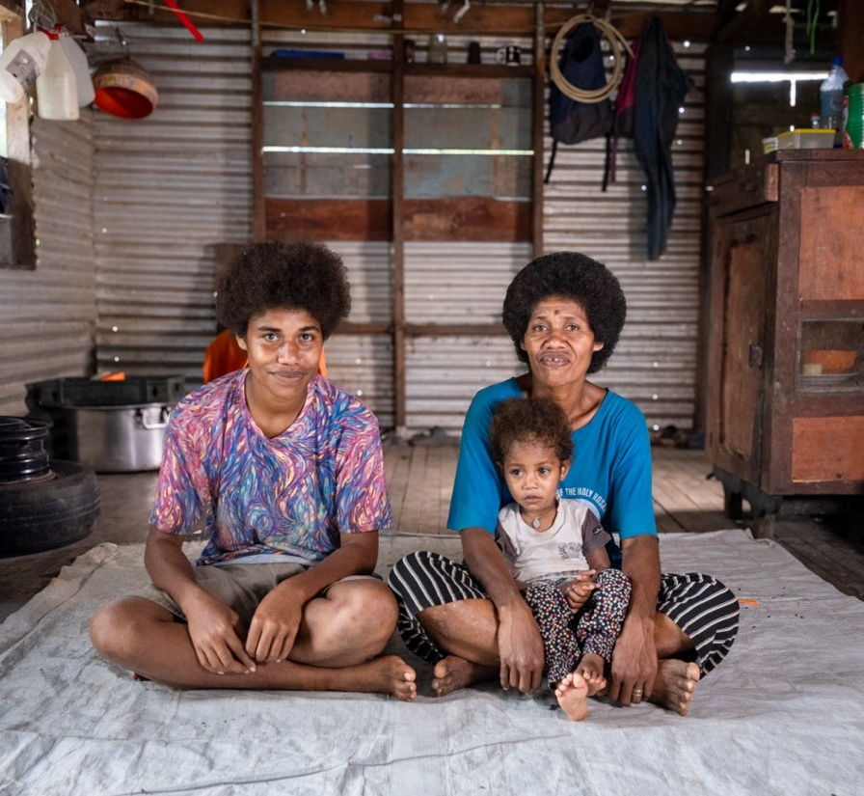
Manaini’s Story
Fiji
In remote northern Fiji, life has always been a struggle for 44-year-old Manaini, a mother of six and grandmother of two.
Meals were often plain and unbalanced,and store-bought food was too expensive.Leftover crops were fed to animals, and atnight the village was in darkness, leavingchildren and the elderly unsafe.
Almost a quarter of Fiji’s population live inpoverty, with higher rates in rural villages,where any extra income can mean thedifference between children completingschool, buying medicine, or covering dailyessentials.

Slide 12
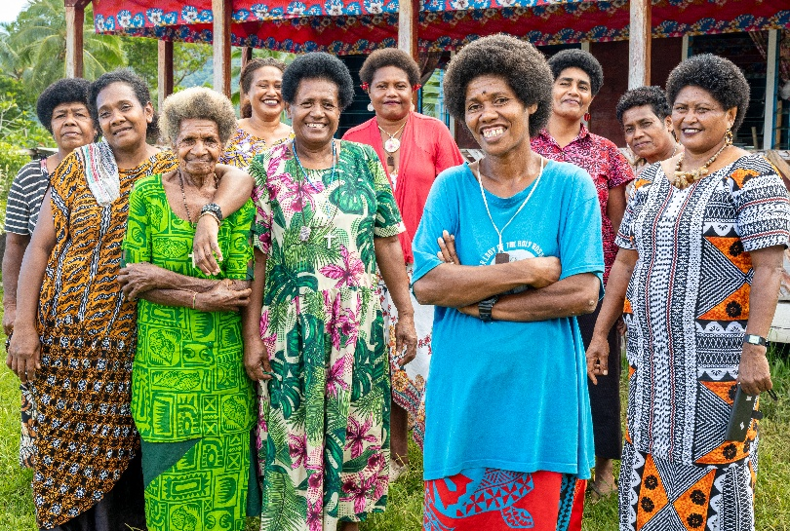
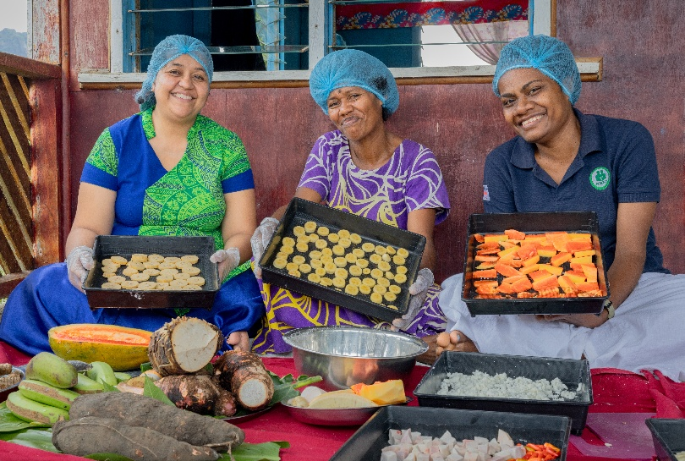
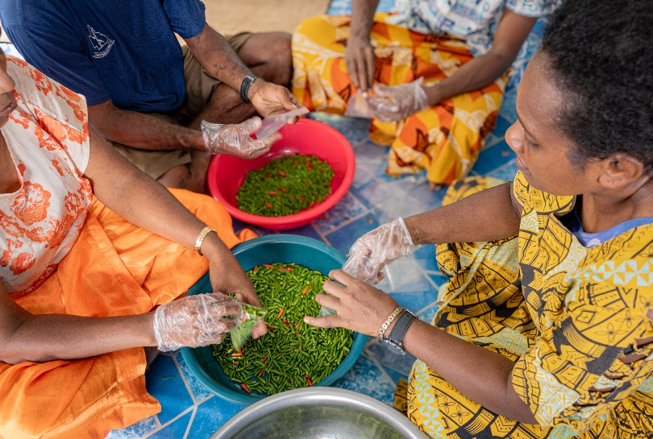
With your help, Manaini and her community are learning new skills from local partner, FRIEND, helping them to live more sustainably.
Manaini is part of a village women’s group that takes part in skills training.
Manaini and her community take part in workshops to learn more about food processing skills.
She learnt about income generation strategies.

Slide 13
Ahmad’s Story
Gaza
Watch Ahmad's Story
Camp for displaced people in Gaza. Photo: Caritas Jerusalem.

Slide 14
Disclaimer
This story was prepared in September 2025. The humanitarian crisis in Gaza continues to evolve daily and circumstances on the ground may have changed since the resource’s production.
Content Warning
The following story includes real images and information from Gaza, which some viewers may find distressing.

Slide 15
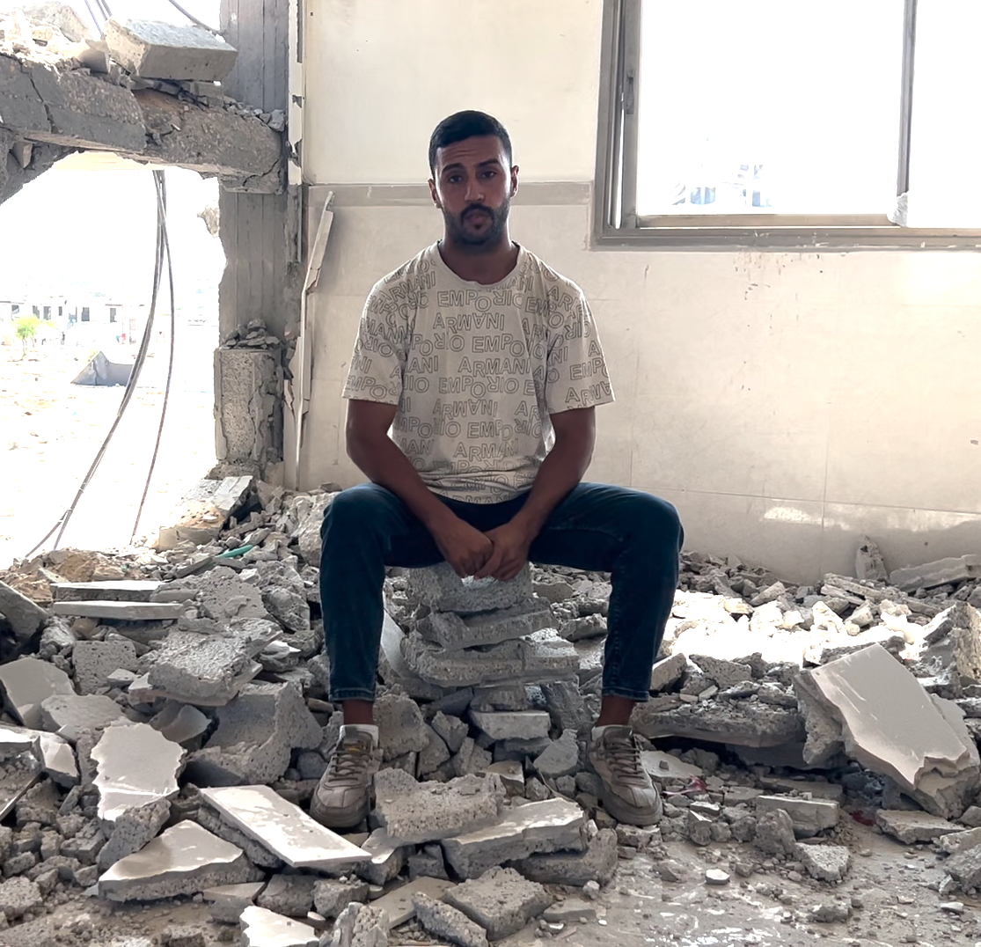
Ahmad’s Story
Gaza
Ahmad, a Caritas Jerusalem staff member living and working in Gaza, has endured repeated displacement during the conflict.
In December 2023, the house where his family was sheltering was bombed, leaving Ahmad injured and his brother with life-changing wounds.
For months they lived between hospitals, tents, and borrowed homes, losing what little they carried each time.
Despite the trauma and displacement, Ahmad continues to serve families through Caritas’ emergency response and hopes that one day the war will end, and Gaza can rebuild.

Slide 16


How can your workplace Unite Against Poverty this Project Compassion?
Together we are helping people like Sisilia, Monoranjon, Manaini and Ahmad
Sign up online to fundraise. Create a team to unite your workplace.
Take on The Long Walk for Water. Walk for just 30mins a day.
Share the Project Compassion stories with your colleagues, family, friends and community.

Slide 17



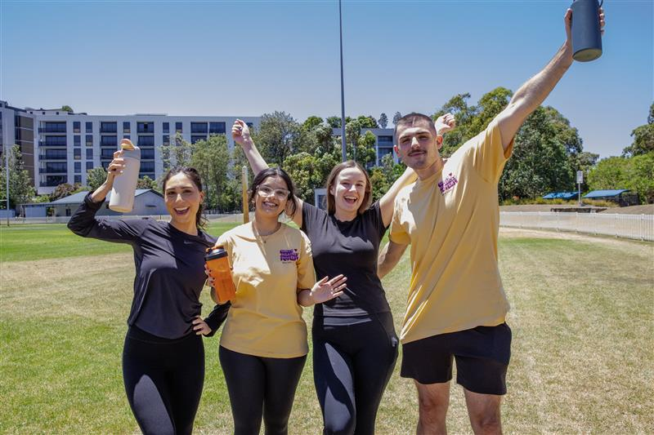

Take on our 40-day walking challenge to help bring clean, safe water to vulnerable communities around the world.
Step 1
Step 2
Step 3
Take the first step toward change!
Sign up for The Long Walk for Water today.
Pledge to walk 30 minutes a day - or any duration you choose.
Let everyone know that you’re taking part in The Long Walk for Water this Lent.
You’ll get fit, feel great, and change the lives of people living in poverty. Ask for your team's support!
For more information, visit: https://www.projectcompassion.org.au/corporates

Slide 18

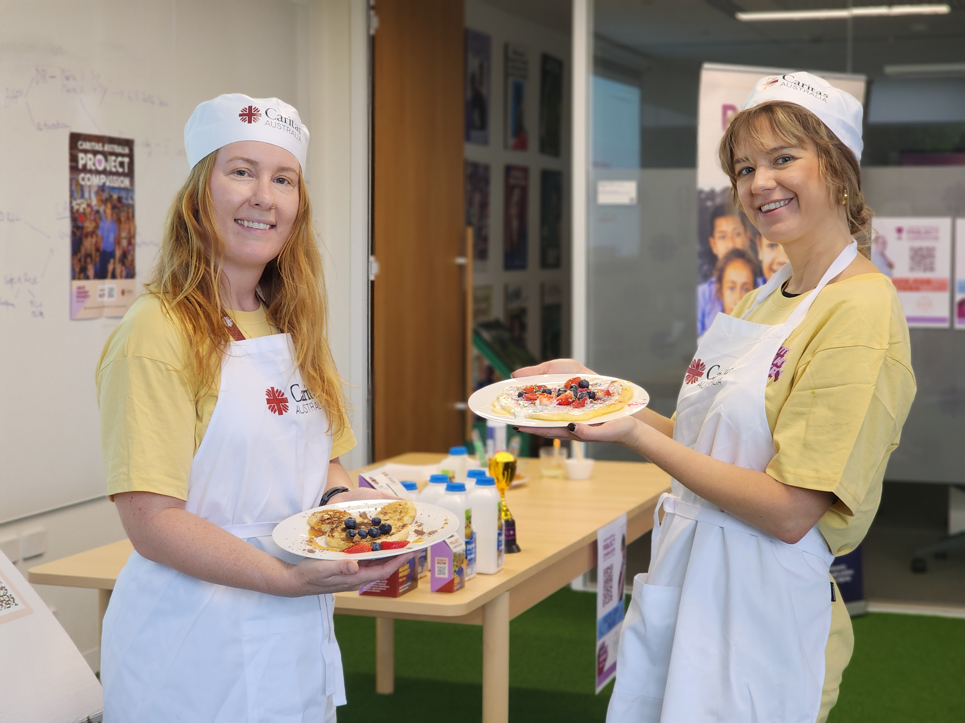


Get together with your team and
Host a Lent Event to raise funds to
empower people to break the cycle of poverty!
Step 1
Step 2
Step 3
Sign up today to Host a Lent Event at your workplace and help change lives.
Choose what Lent event﻿ you'll host. It could be a morning tea, Lunch & Learn or anything you choose!
Be the host with the most﻿ this Lent! Spread the word and start planning your event.
For more information, visit: https://www.projectcompassion.org.au/corporates

Slide 20

Photo Credits
Sisilia’s Story – Caritas Australia
Monoranjon’s Story – Caritas Australia
Manaini’s Story – Caritas Australia
Ahmad’s Story – Caritas Jerusalem

